Slide 1

Presented by Ben Carpenter

Slide 2
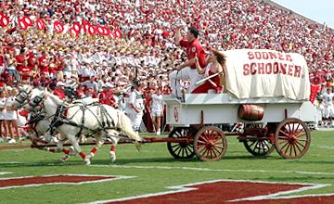


About me

Slide 3

Meet Mongo

Slide 4
NOSQL Data Models
Key-Value Model
Data stored in key-value pairs
Generally no schema is enforced so value types can vary in a single key
Data can only be queried by the primary key
Used by Redis and Riak
Wide Column Model
Data is stored in a sparse multi-dimensional sorted map.
Columns are grouped into families for access or can be spread across families
Data is retrieved by primary key per column family
Used by Cassandra and HBase
Notes:
Both are useful for a narrow set of applications that only need to query by a single key value
Performance and scalability are optimized due to the simple data structure and data opacity
Source: https://s3.amazonaws.com/info-mongodb-com/10gen_Top_5_NoSQL_Considerations.pdf

Slide 5
NOSQL Data Models
Graph Model
Data stored in graph structures with nodes, edges, and properties representing data
Useful when the relationships between records is the main focus of the application
Used by Neo4j and Giraph
Document Model
Data stored in JSON like objects with one or more field each.
Fields can be complex types such as arrays and sub-documents
Used by MongoDB and CouchDB

Slide 6
MONGO vs SQL Considerations
Flexibility
Is your data unstructured or your requirements likely to change?
Scaling
Do you want to be able to scale horizontally or is vertically good enough?
Existing Knowledge/Tools
What other tools are in your stack?
What is your team skilled at working with?
ACID
Notes:
Mongo offers ACID transactions on single documents but not multiples
Atomicity - this is the part mongo doesn't support much
Consistency - mongo is good here
Isolation- depends on how you use it
Durability - mongo is good here

Slide 7
Mongo objects
Field – a named place to store a piece of data about a single document
Can be String, Boolean, Date, Number, Array, Object, etc.
You can think of it like a column in SQL
Document – an object with one or more fields that stores data about one record
When you write queries, you are searching for documents that have matching fields
You can think of it like a row in SQL
Collection – a group of documents of the same type
When you execute queries they are always against a single collection
You can think of it like a table in SQL
Database – a group of collections that are loosely associated
You can run multiple databases on one Mongo instance, but I’m not sure why you would

Slide 8

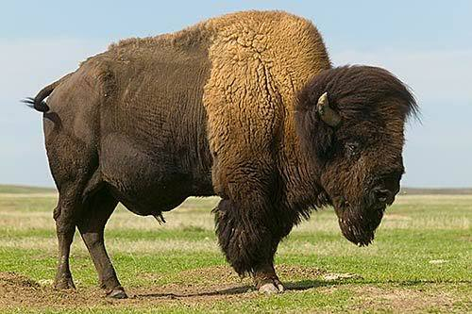
Document Format
Documents and their fields are stored in BSON (Binary JSON) format
BSON is basically JSON that can support a couple of data types not supported by the JSON spec such as Data or BinData
and
Basically the same thing.

Slide 9
Schemaless?
Officially – No
“In MongoDB, documents are self-describing; there is no central catalog where schemas are declared and maintained. The schema can vary across documents, and the schema can evolve quickly without requiring the modification of existing data.”
I would say “Yes*”
*we will talk about an ODM later that lets you add schemas to Mongo
Either way you think about it, Mongo is fine with different documents in the same collection having different fields and it is up to you to decide if and how you want to allow that.

Slide 10
Flexible Schema Example – Tool Inventory
{
“_id”: “12345”,
“brand”: “Dewalt”,
“type”: “drill”,
“sn”: “8357-1123”,
“battery_volts”: “12”,
“chuck_size”: “.5”
}
{
“_id”: “125657”,
“brand”: “Dewalt”,
“type”: “drill”,
“sn”: “8447-7865”, “chuck_size”: “.75”
}
{
“_id”: “23542”,
“brand”: “Milwaukee”,
“type”: “circular saw”,
“sn”: “M2345-87645”,
“battery_volts”: “12”,
“blade_size”: “8”
}

Slide 11
Advantages of Flexible schemas
You can add more fields any time without updating existing records
You can stop putting fields on your documents at any time
If a field only applies to a subset of that collection you can just not add the field to the models that don’t need it (you can also just set them to null)
You can start coding before you have a fully formed plan and let things (d)evolve naturally

Slide 12
The _id field
Every document has a field named “_id”
You can set it to anything you want during document creation
Or you can let Mongo generate it for you
It becomes an ObjectID which is a wrapper around a 12 byte hexidecimal consisting of:
a 4-byte value representing the seconds since the Unix epoch
a 3-byte machine identifier
a 2-byte process id
a 3-byte counter, starting with a random value.
It will be unique and sorting on it roughly gives chronological order of creation
This field cannot be changed once a document is created

Slide 13
Basic Operations
db.collection.insert() – add a document to the current collection
db.collection.save() – either add a document or replace an existing one
db.collection.find() – query for documents that match the passed query
db.collection.update() – update specific fields in one or more documents
Can be used to replace every field except _id like save but that’s less common
db.collection.remove() – deletes all documents that match the passed in conditions.
Notes:
Save will do an insert if the document passed has no _id and otherwise it does a replace

Slide 14

Working with Mongo

Slide 15
Robomongo
A super handy free client to connect to your mongo DB for inspecting and changing data
Lets you run any mongo command directly
Also lets you edit the raw BSON representation of documents.
Remove documents and collections quickly

Slide 16
Mongoose
This is the main ODM for using MongoDB in Node.js applications
It lets you define schemas and validators.
It wraps and manages the connection to the DB for you.
It adds features like virtual fields and getter/setter
It allows you to ‘join’ documents via the populate function

Slide 17
Mongoose Example Schema
var HubSchema = new mongoose.Schema({
date_created: { type: Date, required: true, default: Date.now },
key: { type: [{ type: Number }], required: true, default: enc.generate_key },
deactivation_date: { type: Date, required: false },
model_name: { type: String, required: false, uppercase: true },
state: { type: String, required: true, default: 'active', enum: c.HUB_STATUS_ENUM },
fw_version: { type: String, required: false, set: fwSetter },
fw_history: [{ date: Date, fw_version: String, _id: false }],
sensors: [{ _id: { type: String, uppercase: true, ref: SensorModel}, add_date: { type: Date }}]
});

Slide 18
Mongoose Example Schema (continued)
function fwSetter(newValue){
return helpers.logHistory(this, newValue, 'fw_version', 'fw_history');
}
HubSchema.methods.addSensor = function(sensor_id, cb){
this.sensors. push({_id: sensor_id, add_date: Date.now()});
return this.save(cb);
};
HubSchema.virtual('isActive').get(function () {
if (this.deactivation_date && (this.deactivation_date < Date.now())) { return false; }
return true;
});
HubSchema.set('toJSON', { getters: true }); //use getters and virtuals when generating JSON
HubSchema.index({ 'date_created’ : -1 });

Slide 19
Database Design
Build documents to match how you plan to access them
Subdocuments are handy when data will always be accessed as part of the larger object
Making a separate document with a pointer is better if the child documents may be accessed outside the context of the parent document or if you rarely care about that data when viewing the parent.
You want to avoid boundless document growth because if a document grows too much it may need to be moved to a different part of the disk which can be costly if the disk is in high demand.

Slide 20
Database Design Example
Imagine DB storing recipes
Each recipe has:
A title
An author
A list of ingredients with an amount for each ingredient
A block of instructional text
A list of comments from other folks each with text, a date, and an author

Slide 21
Database Design Example
Title and instructional text should be fields of the recipe document
Author should be a field of the recipe.
Probably a reference to a document in a User/Author collection
The list of ingredients with an amount for each ingredient makes sense as a subdocument
It won’t grow much over time
None of the individual lines make much sense outside the context of this recipe
There is little reason to ever access the recipe data without accessing this data as well
The list of comments should probably be a separate collection.
It could grow boundlessly and you might want to show the recipe in situations where comments aren’t relevant.

Slide 22
Queries
Queries are based on finding documents with any combination of fields in a collection
tool_models.find( { brand: “Dewalt”, type: “drill”, chuck_size: { $gt: .5 } } );
You can also do inline sorting and limits to easily paginate
tool_model.find( {} ).sort( { type: 1 } ).limit( 20 ).skip( 20*(page-1) )
OR/AND logic is also supported (though the default is AND so explicit ANDs are rare)
tool_model.find({ $or: [{brand:"Dewalt"}, {brand:"Milwaukee"}, {type: "table_saw"}]})
You can also filter on the existence of field
tool_model.find( { battery_volts: { $exists: false } } )

Slide 23
More advanced queries with Aggregation
Aggregations operations process data records and return computed results.
Aggregation operations group values from multiple documents together, and can perform a variety of operations on the grouped data to return a single result.
MongoDB provides three ways to perform aggregation:
aggregation pipeline
map-reduce function
single purpose aggregation methods
Notes:
Source: https://docs.mongodb.com/manual/aggregation/

Slide 24
Aggregation Pipeline
Modeled on the concept of data processing pipelines.
Documents enter a multi-stage pipeline that transforms the them into an aggregated result.
The most basic pipeline stages provide filters that operate like queries and document transformations that modify the form of the output document.
Other pipeline operations provide tools for grouping and sorting documents by specific field or fields as well as tools for aggregating the contents of arrays, including arrays of documents.
Pipeline stages can use operators for tasks such as calculating the average or concatenating a string.
Notes:
Source: https://docs.mongodb.com/manual/aggregation/

Slide 25
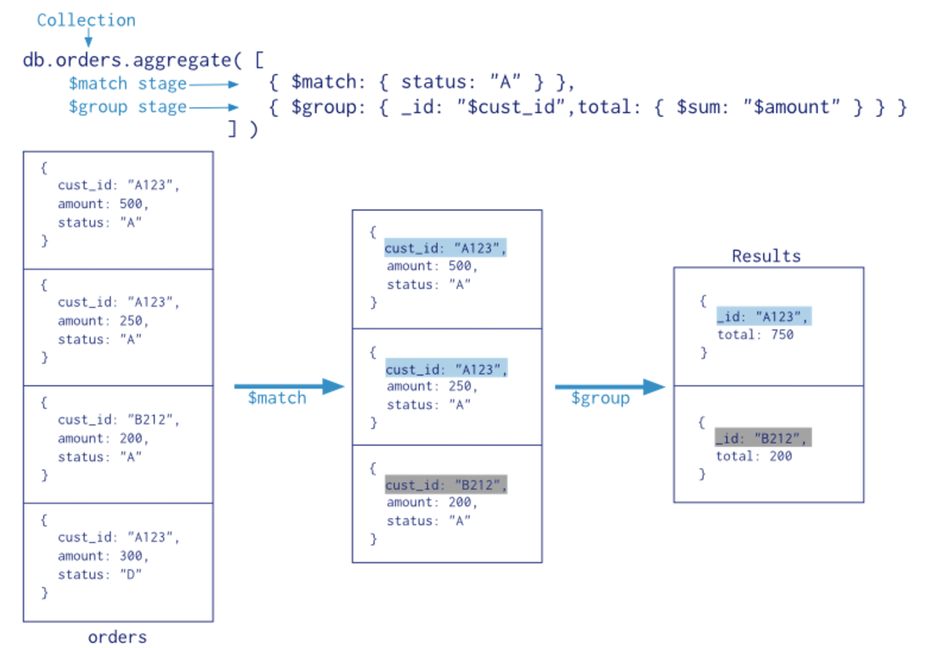
Aggregation Pipeline
Notes:
db.getCollection('toolmodels').aggregate([{$match: {battery_volts: {$exists: true}}}, {$group: {_id: { brand: "$brand", volts: "$battery_volts"}, total: {$sum: 1}}}])
Source: https://docs.mongodb.com/manual/aggregation/

Slide 26
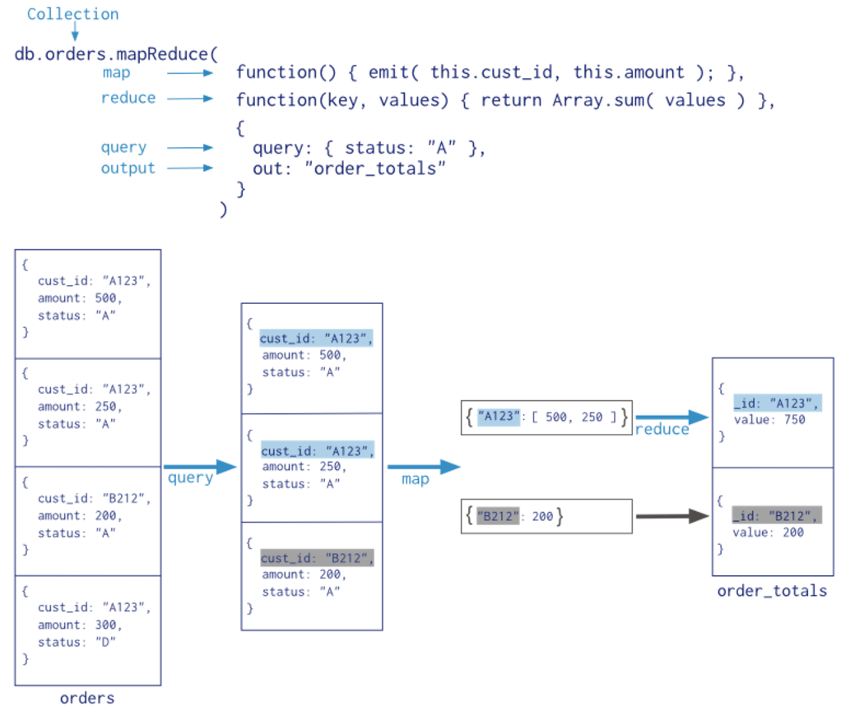
MaP-Reduce
“For most aggregation operations, the Aggregation Pipeline provides better performance and more coherent interface. However, map-reduce operations provide some flexibility that is not presently available in the aggregation pipeline.”
Notes:
Source: https://docs.mongodb.com/manual/aggregation/

Slide 27
Single Purpose Methods
db.collection.count( query ) – returns only the number of documents in the collection that match the query
db.collection.distinct( field, query ) – returns an array of all the unique values found in the passed field for the documents that match the query
db.colleciton.group( settingsObject ) - returns an array of new objects each matching a unique combination of values in the fields you request to group by, based on a query, a seed document, and a function to perform on matching documents.
db.orders.group( {
key: { ord_dt: 1, 'item.sku': 1 },
cond: { ord_dt: { $gt: new Date( '01/01/2012' ) } },
reduce: function( curr, result ) { result.total += curr.item.qty; },
initial: { total : 0 }
} )
Notes:
Source: https://docs.mongodb.com/manual/aggregation/

Slide 28

Common Pitfalls

Slide 29
A Common Code flow (in Node)
Foo = function( tool_id, cb) {
tool_models.findById(tool_id, function(err, tool){
if (tool.brand == “Milwaukee”) {
tool.color = “red”
return tool.save(cb)
}
return cb(null, tool);
});
};

Slide 30
Update vs. query then save
Most people (at least the code I have seen) tend to query for documents, edit the documents, then save those documents
This will overwrite any other changes that happened on the document since your query
Using the update functions lets you change only the fields you need to without changing any other fields
Update is almost always safer but is also often harder to write your application code around.

Slide 31
Multiple level Nested Arrays
{ _id: “2345”, price: “22.85”, colors:[
{ color: “red”, sizes: [
{ size: “S”, quantity: 5 },
{ size: “M”, quantity: 3 }
]},
…
]}
Notes:
There is an operator “$” that gets replaced by a single matching element in an array. It only works for one level though.

Slide 32
Unnecessary duplicate data
You should design your models to match how your application will access the data up to a point
It can be tempting to store the same piece of date in several collections rather than following references
Sometimes it makes sense, but it is very easy to get carried away

Slide 33

Putting the Humongous in Mongo

Slide 34
Scaling and Sharding
Sharding breaks the data in your database into multiple pieces that can be spread across different partitions of a server or across multiple physical servers to support horizontal scaling.
It is automatic and built into MongoDB so you don’t have to write sharding logic into your application.
Shard keys are indexed fields that exist on every document in the collection
There are different sharding schemes to choose from
Each shard can hold one or more chunks
Notes:
Source: http://s3.amazonaws.com/info-mongodb-com/MongoDB_Architecture_Guide.pdf

Slide 35
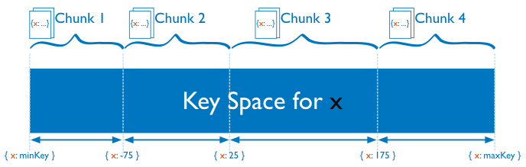
Range Based Sharding
Divides the spectrum of possible values for the shard key into “chunks”
Documents are stored on the shard that matches the chunk they fall into
Attempts to keep documents with similar key values in the same shard
Notes:
Survey respondent age might be a good candidate
Source: https://docs.mongodb.com/manual/core/sharding-introduction/

Slide 36
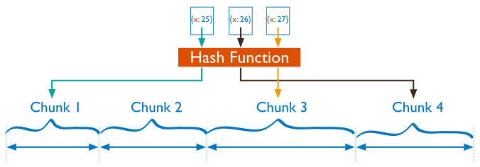
Hash Based Sharding
Uses the results of a hash function to create chunks
Documents with similar key values are unlikely to be in the same chunk
Helps to give a more random distribution of a collection in the cluster
Notes:
Source: https://docs.mongodb.com/manual/core/sharding-introduction/

Slide 37
Chunk Management
Mongo uses 2 background processes to try to keep all the shards relatively balanced
Splitting will break a chunk in half when documents inserted or updated push it over a set chunk size
This is a metadata change only and does not migrate data
Balancing will move chunks from the shard with the largest number of chunks to the shard with the fewest chunks
This operation does migrate data and does fancy stuff to make sure updates to the documents during the move are handled appropriately.
This is all FYI because it is automatic and you don’t really have to worry about it
Notes:
Source: https://docs.mongodb.com/manual/core/sharding-introduction/

Slide 38
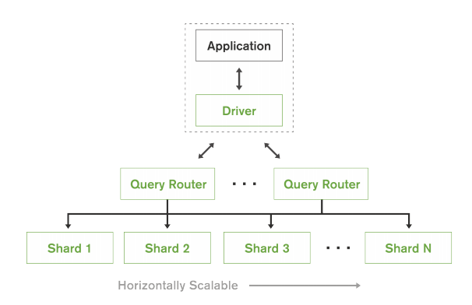
Query Router
Key-value queries based on the shard key will dispatch the query to the shard that manages the document with the requested key
Range-based sharding with queries that specify ranges on the shard key are only dispatched to shards that contain documents with values within the range
Other queries will broadcast the query to all shards, aggregating and sorting the results as appropriate
Notes:
The query router is built in to MongoDB and handles deciding which shards are searched.
Source: http://s3.amazonaws.com/info-mongodb-com/MongoDB_Architecture_Guide.pdf

Slide 39
Questions?

